Slide 1
READ THIS FIRST Make a copy of this file to your personal computer/onedrive before editing anything
Use this as a template for you section 1 on installation
Edit any way you wish. That includes adding or removing content.
Make it fun. Class is more fun when the TA is also having fun.
Don't forget to delete this slide when you're done.

Slide 2
Introduction to Data Science
TA Section < SECTION # >
WELCOME !!!!

Slide 3
WELCOME TO 553.436/636!
TA: < Name >
Email: < Email >
Section: < Section Number >, < Day and Time >, < Location >
Office Hours: < Day and Time >, < Location >

Slide 4

Install python and jupyter notebook

Slide 5
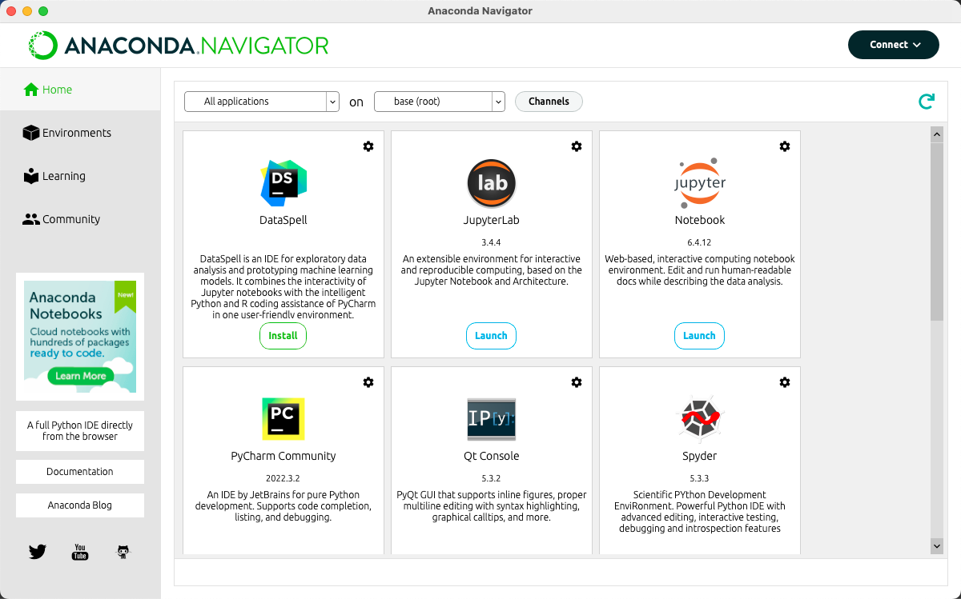
Anaconda

Slide 6
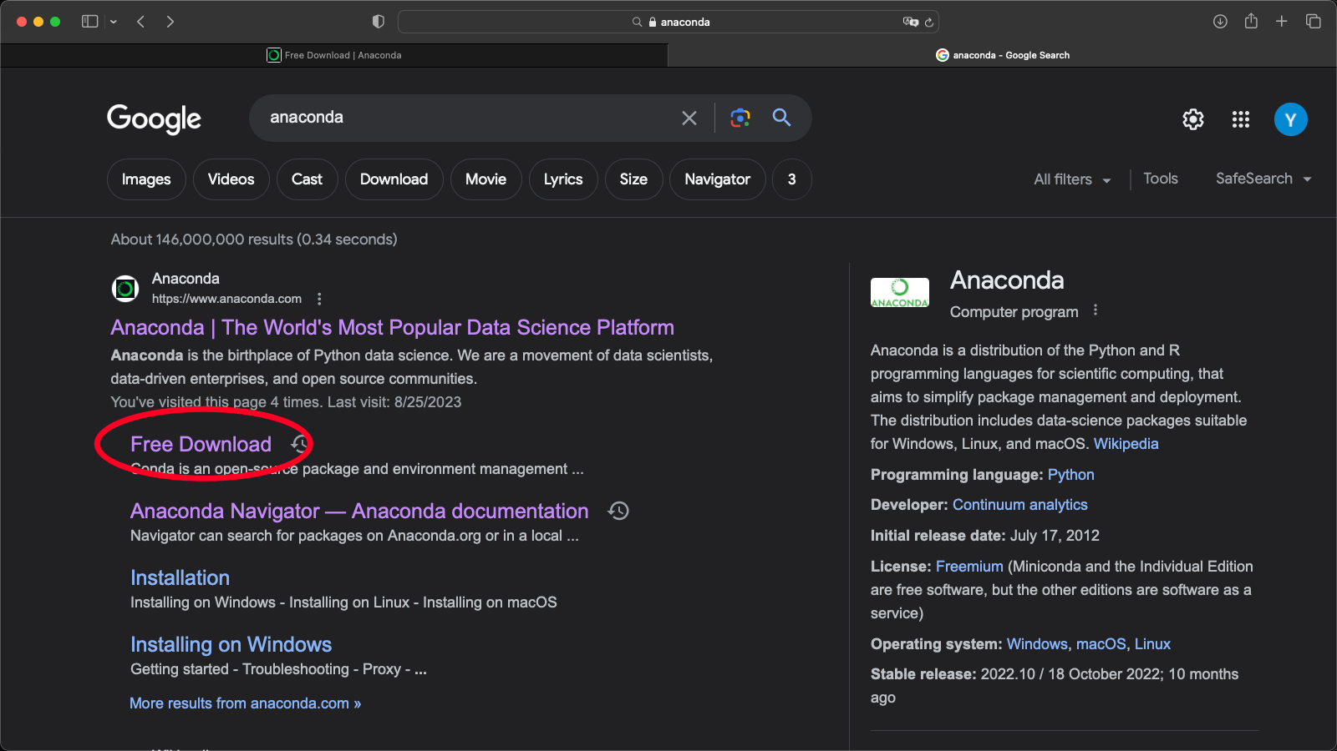
Anaconda

Slide 7
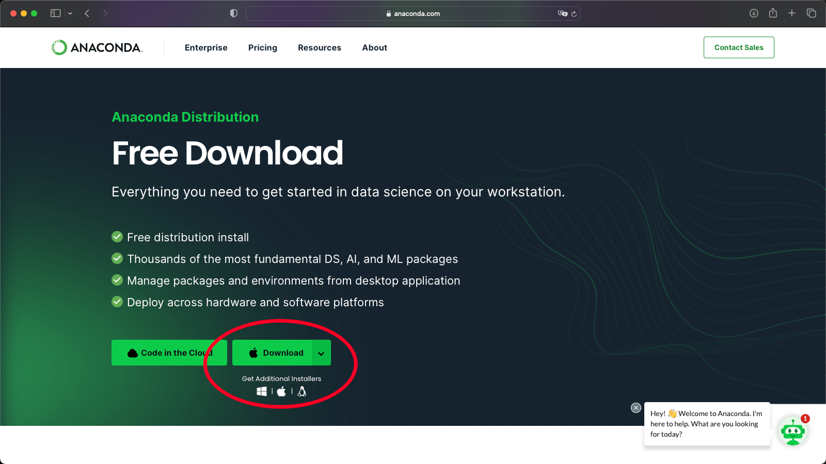
Anaconda

Slide 8
Anaconda Installation Help
https://docs.anaconda.com/free/anaconda/install/index.html

Slide 9
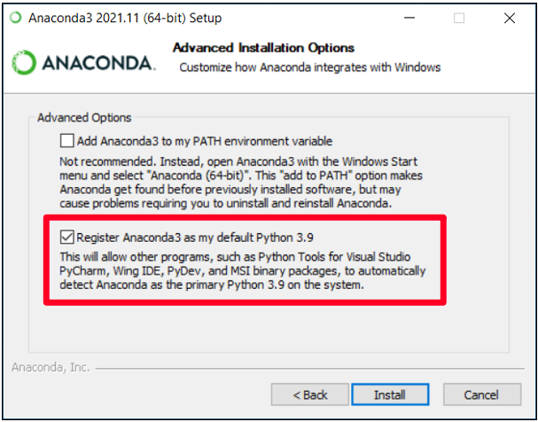
For Windows

Slide 10
Package Managers (like pip, conda)
Pip and Conda are both package managers for the respective Python Distributions.
Package managers are software tools that simplify the process of installing, updating, and managing software packages and their dependencies.
They provide a centralized repository of packages and handle the installation and configuration of those packages on your system.

Slide 11
2. Test if installation worked
Download lecture Jupyter notebooks from Canvas.
Test to see if you can run all cells.
If you are new to Python/jupyter/coding, take the remaining time in section to review the lecture notebooks.
Understand every line of code/how it works.
Try to replicate the given code from memory.
Ask your TA questions if you need help.

Slide 12
3. How to set up Virtual Environments
Helpful to have but not necessary

Slide 13
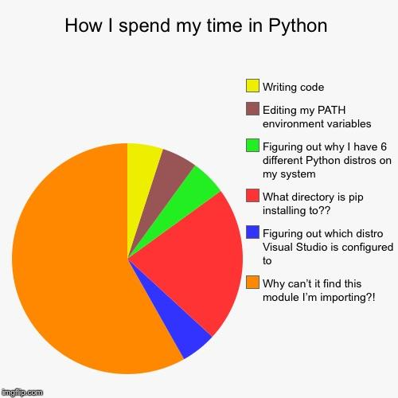

Slide 14
The solution: Virtual Environments!!!
A virtual environment provides a self-contained environment where you can install specific versions of Python packages and their dependencies without affecting the global Python installation or conflicting with other projects.

Slide 15
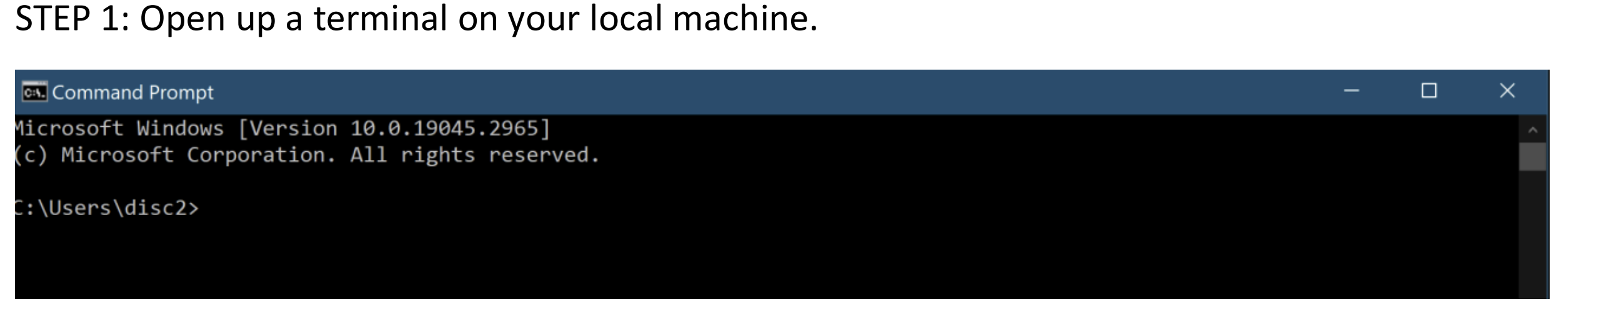
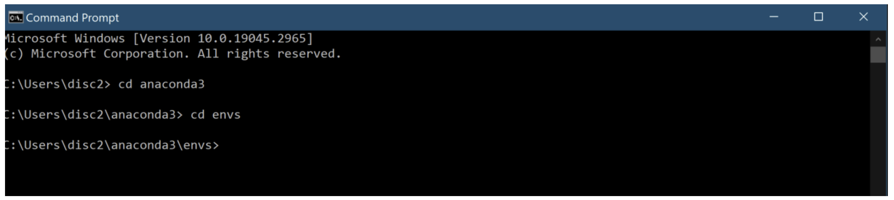
Let’s make one…

Slide 16
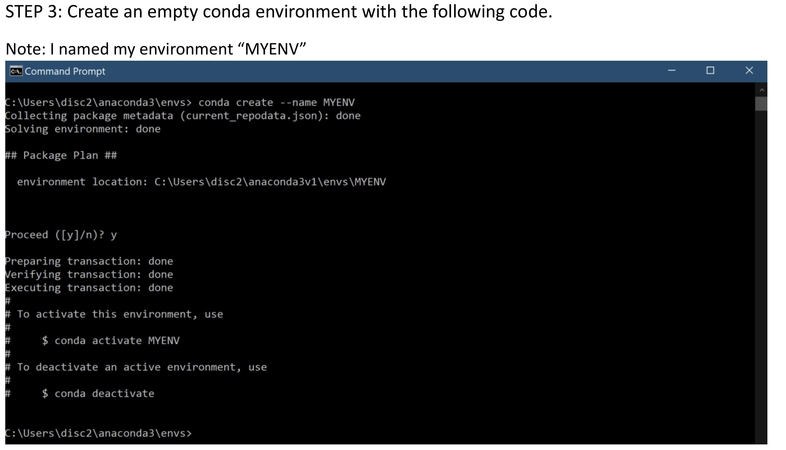

Slide 17
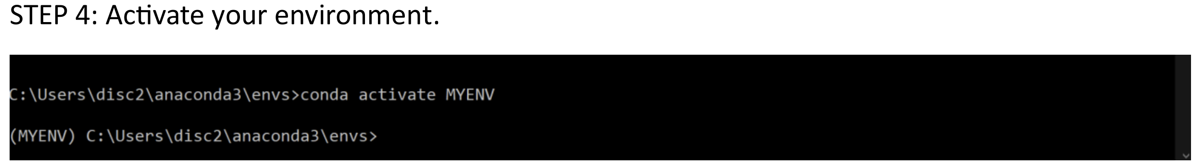
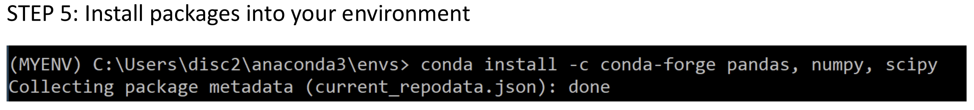

Slide 18
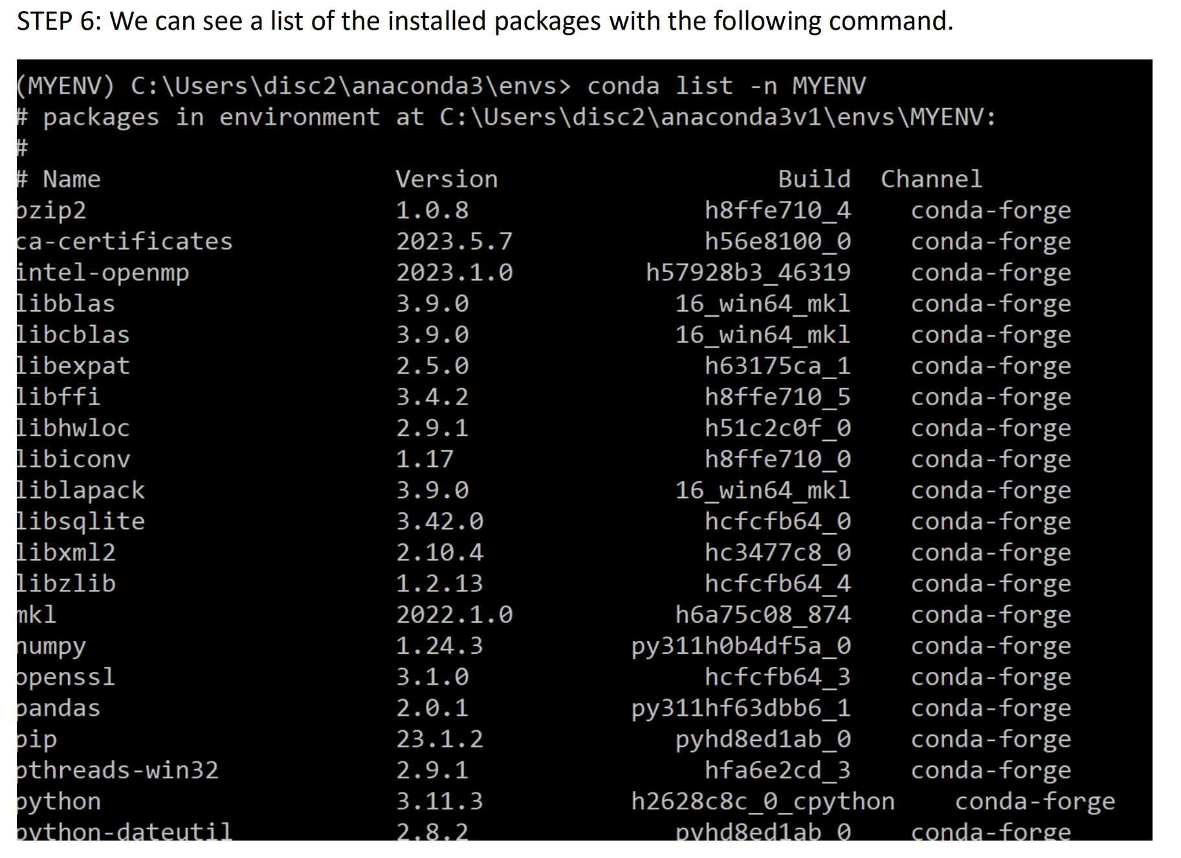

Slide 19
